Slide 1
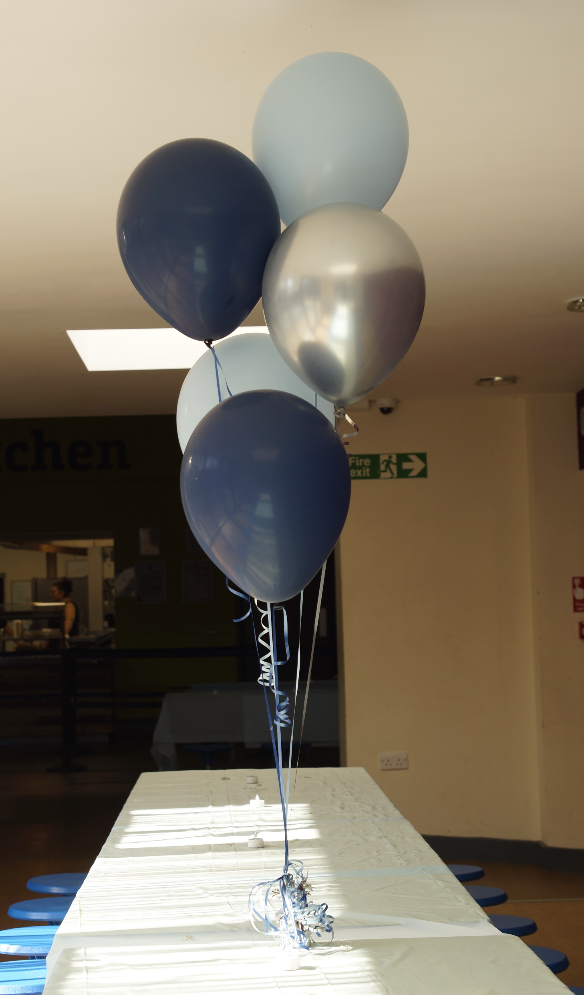
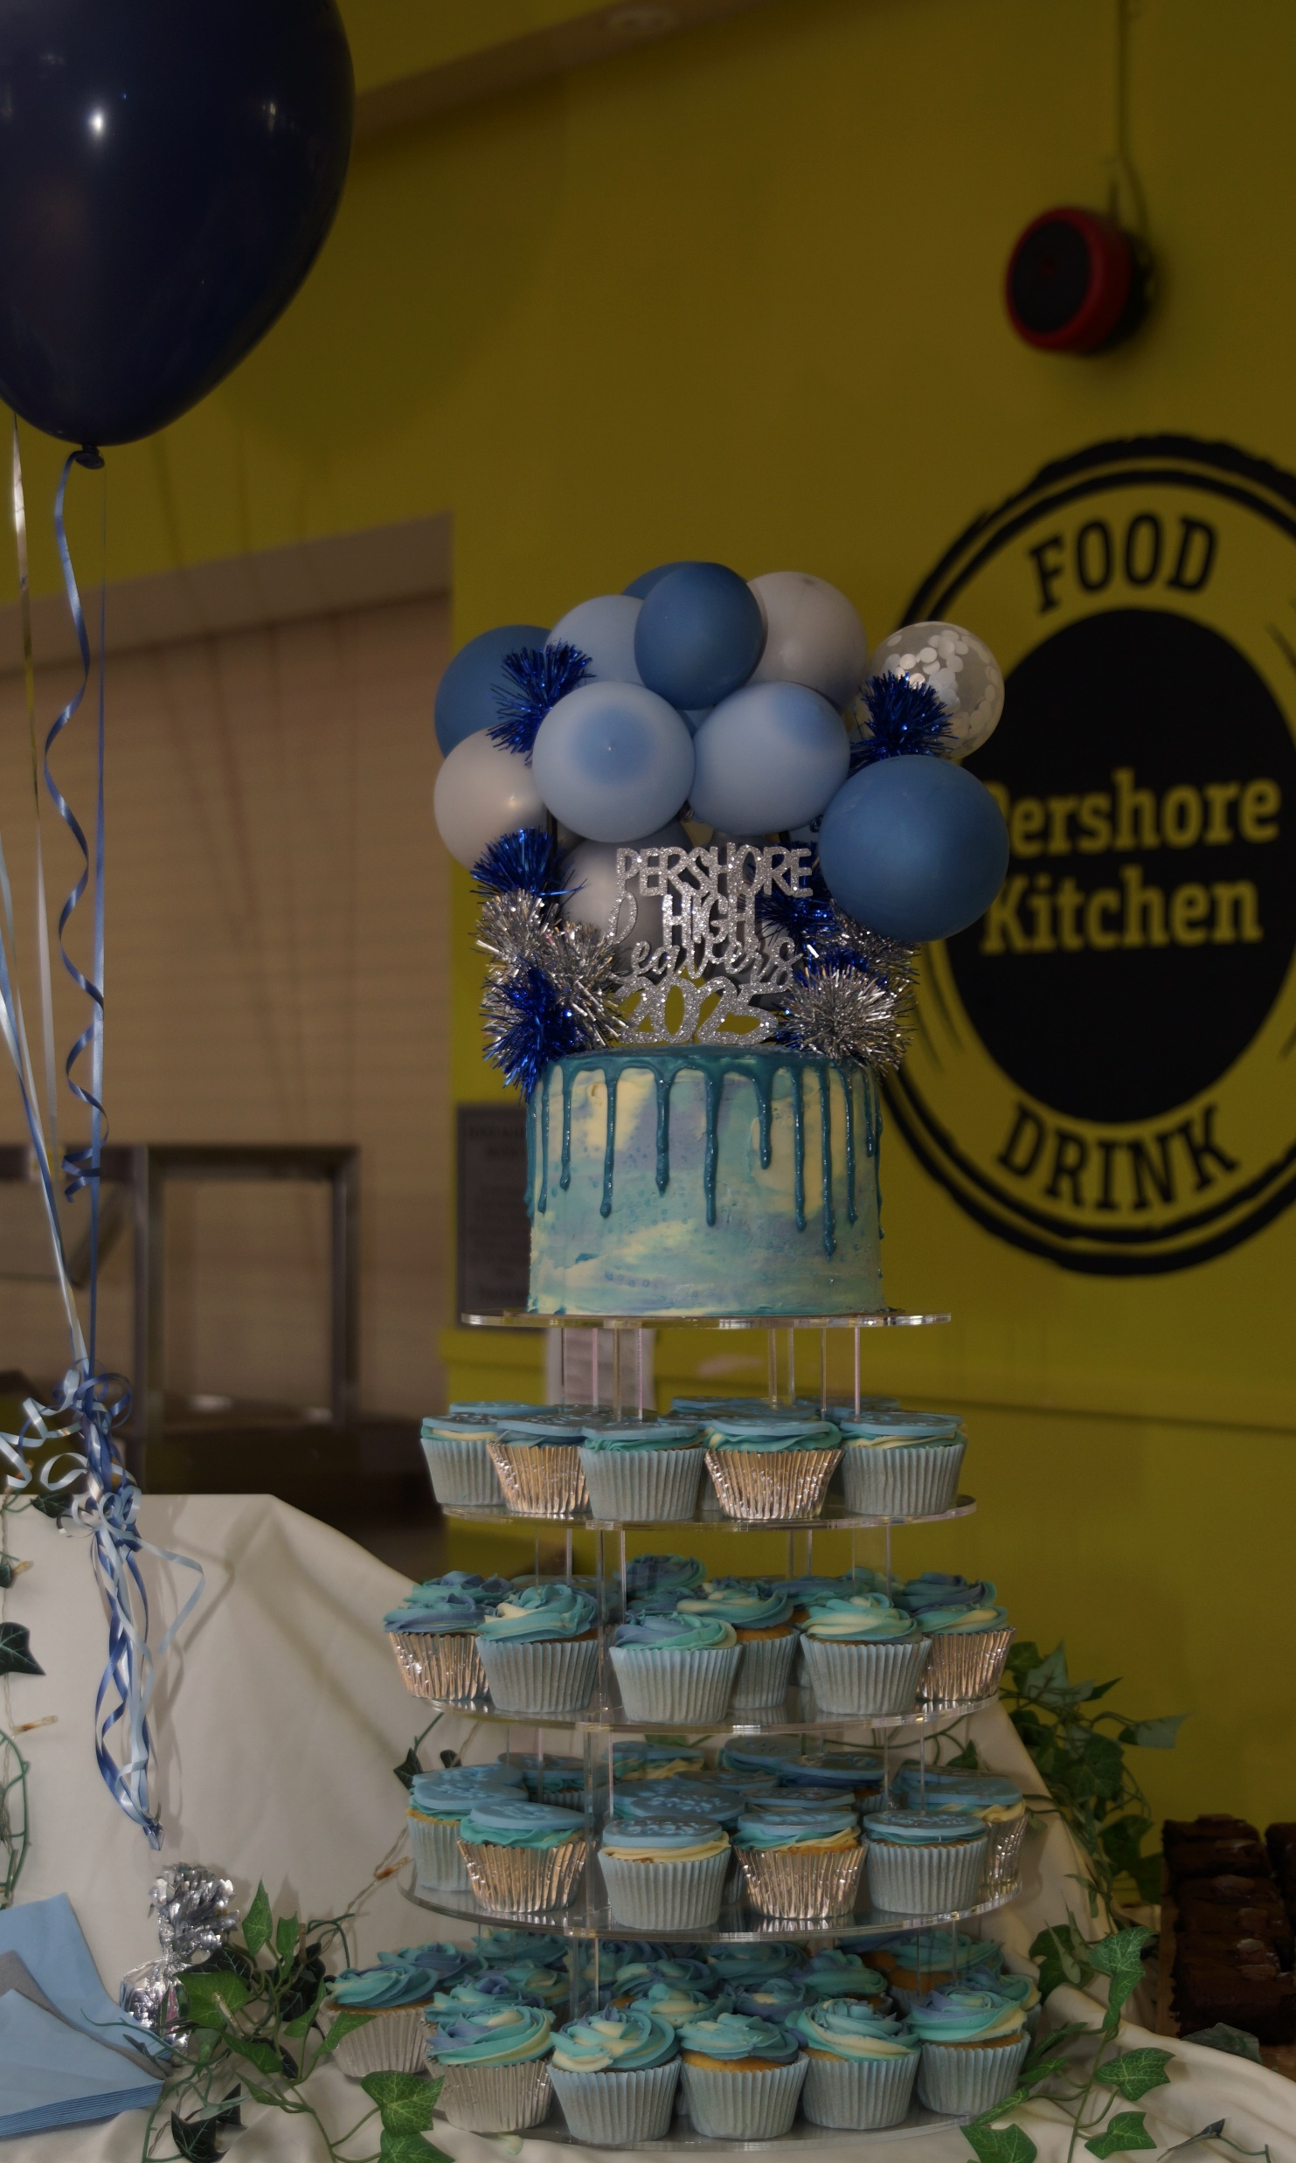
Prom 2026
PROM 2026
The next fundraising event is the cake sale on the 21st November so get baking and bring your donations in on the day to the Armstrong office. The cake sale will be held at lunchtime
Friday
26th June

Slide 2
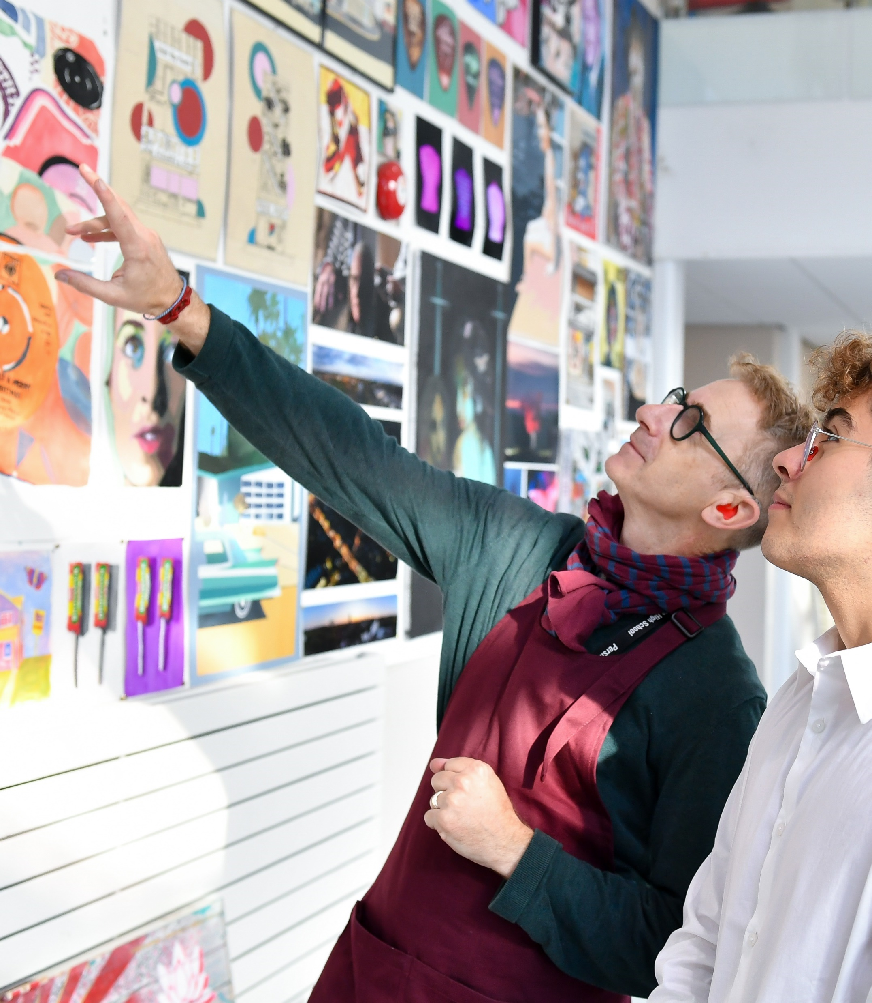

PERSHORE SIXTH FORM
Thursday 20th November 2025 from 6-8pm
OPEN EVENING
  Explore your options
  Meet the team
  Speak with students
Why choose Pershore Sixth Form?
  Exceptional academic achievement.
  Personalised pastoral care and guidance.
  Extensive enrichment opportunities.
  A modern, well-resourced Sixth Form centre.
    To find out more, contact:
    Zoe Starkey - Head of Sixth Form
    zs@pershore.worcs.sch.uk
    01386 552471 ext. 220

Slide 3
Your voice matters – and shapes your Sixth Form experience
We Listen. We Act.
You asked for more independence
✅ Lanyards = greater freedom
➤ No more daily AM tutor
➤ Flexibility to leave site when you have no lessons
✅ Dress code
➤ Still smart, but with more choice
✅ Your voice matters – and shapes your Sixth Form experience

Slide 4
Destinations
12 Oxbridge, Medicine, Veterinary and Dentistry applicants
80% of our students applied to university. All were offered a place
The remaining students secured successful apprenticeships/employment
We have one of the highest records for securing places at Oxford and Cambridge university from any state school and colleges in Worcestershire

Slide 5

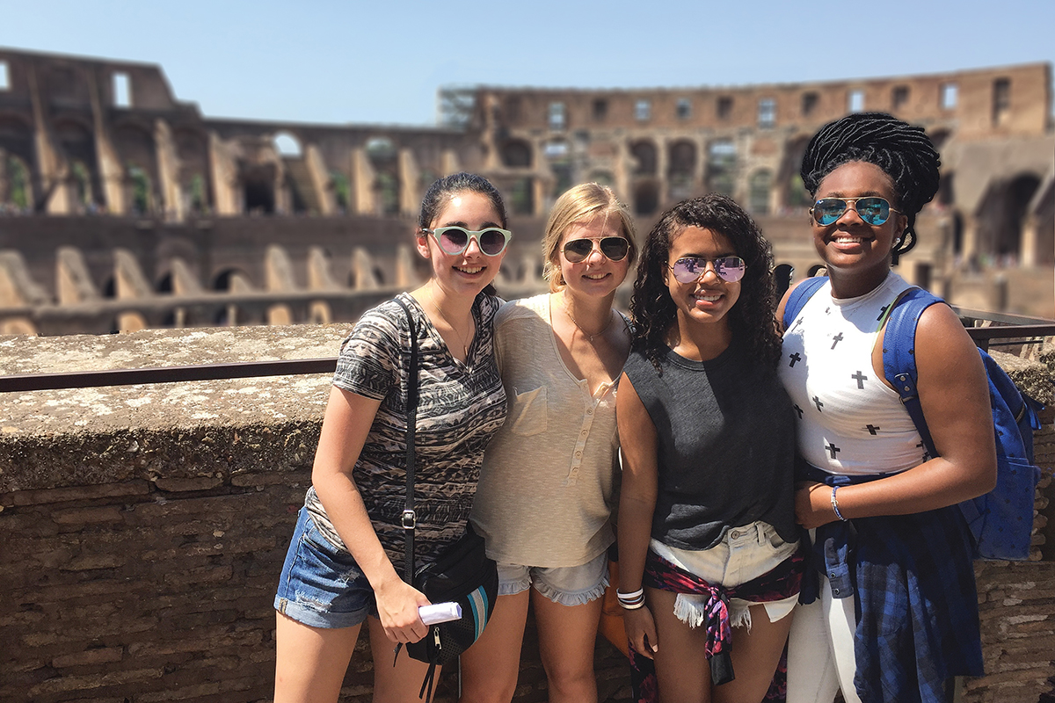

Opportunities
TEFL
Gap year
Studying Abroad
Travel
Project Trust
Camp America

Slide 6
WHY PERSHORE?
  Outstanding Examination Results
  Consistently High Value Added
  One of top performing in the county
  Support/Effective Academic Monitoring
  Small class sizes
  Unrivalled careers, apprenticeship and university guidance
  We know you. We are big enough for choice, small enough to care.
  Specialised programme for students wishing to apply to Oxbridge, Medicine and other Competitive courses.

Slide 7
NEXT STEPS
Do your research
Be mindful when making selections. For Medicine you will need Chemistry and Biology.
Law-Top universities prefer students to study English or History at A level (not Law or Criminology A Level)
All students will be offered an interview for Sixth Form. (November/December)
Attend Open Evening – Thursday 20th November (6pm-8:00pm)

Slide 8
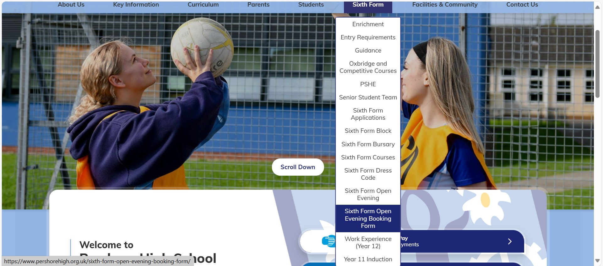
You can find all the information you require here
Sixth Form Bookings

Slide 9


6th Form New York Trip 2027

Slide 10

6th Form NYC Trip 2027
Departure date from UK
Thursday 11 February
Return date to UK Monday 15 February
Duration of tour
5 days, 4 nights

Slide 11
The price of the trip is subject to confirmation once the flights are released and the hotel rooms are booked, but we anticipate the cost will be no more than £1899 spread across 12 months. This is a lot of money, but it includes:
Visits included are:
Times Square & Herald Square
Top of the Rock at Sunset
9/11 Memorial
American Museum of Natural History
Broadway Show
Statue of Liberty Cruise and Battery Park
9/11 Memorial
Central Park
Brooklyn Bridge Hi-Line walk
Shopping! Macy’s, Bloomingdale’s, 5th Avenue
And more to be announced!
Return UK airport transfers from and back to school
Return flights from London to New York
ESTA visa
A hotel close to Times Square for 3 nights on a bed & breakfast basis
3 evening meals at local restaurants such as Hard Rock Café, Ellen’s Stardust Diner and Margaritaville

Slide 12

More details and next steps…
There is more information about the activities and cost of the trip in the letter which will be sent to you and all Y11 parents and carers by the end of this week.
If you are interested in coming with us, you will need to complete the expression of interest MS Form that will be linked in that email. There are 40 places available.
You can only apply if you are coming back to Pershore Sixth Form in September 2026 (obviously ☺)
Once we have confirmed that the trip has enough interest to run, we will be in touch with a more detailed itinerary, costing and deposit amount needed to secure your place.

Slide 13
Any questions? Find me in H3 tomorrow break time ☺

