Slide 1
Welcome to
Pershore High School
Sixth Form Open Evening
20th November 2025

Slide 2
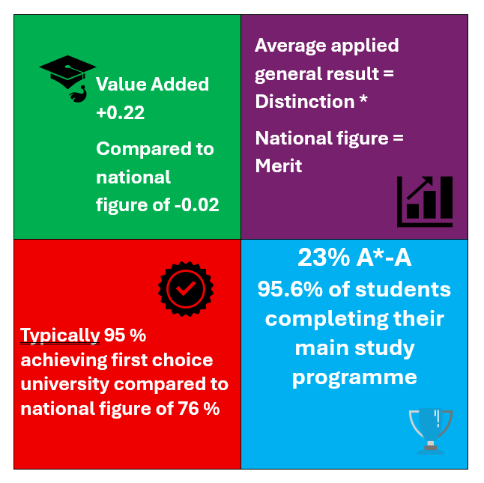
WHY PERSHORE SIXTH FORM?
  Excellent teaching by subject specialists
  High quality Pastoral Support
  Effective Academic Monitoring
  Small class sizes
  High level of contact time
  Consistently one of the top A Level providers in Worcestershire

Slide 3
Excellent results placing Pershore as one of the highest providers in the county
Measure | Pershore Sixth Form 2025
Average A Level Result / Points Score | C+ / 33.94
Progress Measure (Value added) | +0.22
Average Applied General Result | Distinction +
% of students completing their main study programme | 95.6%
% of A* / A grades | 23%

Slide 4
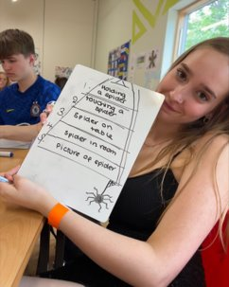
Student Progression
On average 83% of our students progress on to university – significantly higher than national average
Typically, 95% get their ‘First Choice’ university
All other students successfully secured apprenticeship or employment.
No student leaves Sixth Form without a secure pathway

Slide 5

Head Team
Ellis Harding Head Student
Millika Brittle Head Student
Aimee Martin Deputy Head Student
Jack Bradley Deputy Head Student
The Senior Team

Slide 6
Why should you CHOOSE Pershore Sixth Form?
Great results
Size
Effective Studying
Academic monitoring
Class Sizes
Social
Trips
Expert Teachers
Sixth Form Centre
Pastoral Support and Guidance
Courses

Slide 7
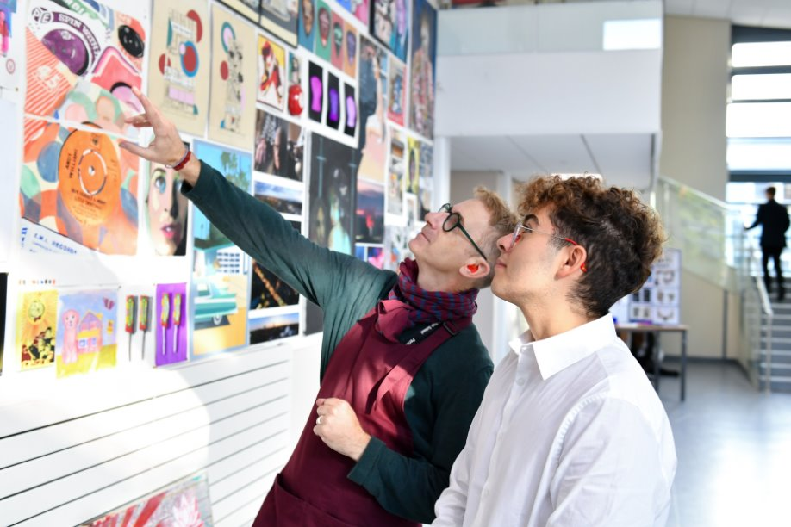
Lots of teacher contact time
9 Contact lessons with specialist
10th lesson for assessment for each subject (supervised exam conditions; regular ‘low-stakes’ testing and feedback)
4 Timetabled Study lessons
2 lessons of Elective choices
1 Careers Guidance lesson
1 PSHE / Tutor lesson
40 / 50 hours with staff per fortnight

Slide 8
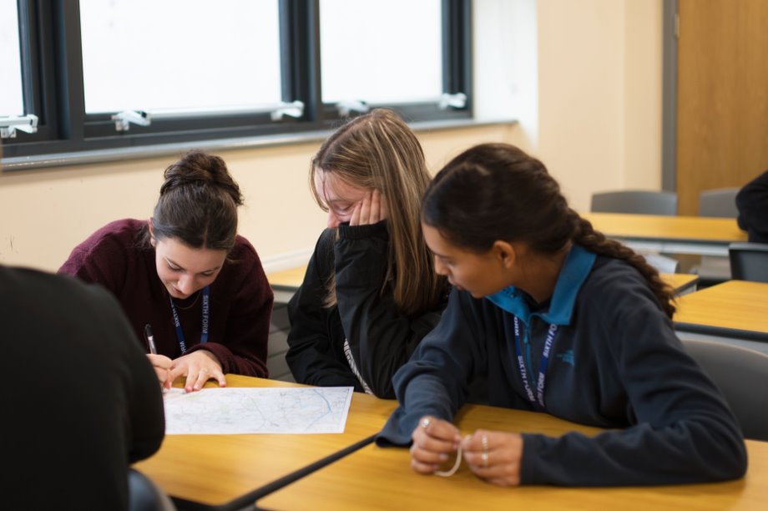
Support for the Future and Preparation for Life
Every Monday 9-10am
UCAS support every Monday 3:30pm
Dedicated careers sessions
University application guidance
Mock Interviews, CV and apprenticeship support
Spotlight on Careers
Futures Programme - not just university
Specialist Pastoral Tutors

Slide 9
Aspire Programme
Supports students considering applications to Oxbridge, Veterinary Science, Medicine, Dentistry and other highly competitive courses at the top universities.
Mock Interviews (external/internal)
Masterclasses
Tutorials on applying, preparing them for the highest academic rigour
HE plus
Academic Scholars Programme
Essay writing competition
View from the Sixth Form: Callie Harris

Slide 10
Enrichment and Elective Programme
Politics AS Level
Extended Project Qualification (EPQ)
Gold Duke of Edinburgh Award
Engineering Education Scheme
Young Enterprise
Sports Leadership Award
Arts Award
Italian
Spanish
Academic Scholars
Modern Foreign Languages Leader Award
Drama (Lambda Exams)
Recreational Sport
Survival (Culinary Skills)
Community Service
Classroom Support
First Aid
Peer Mentoring
Volunteering
MOOCs

Slide 11





Bursary

Slide 12
Sixth Form Considerations
Course - Is this the best option to get me to where I want to be?
Class sizes and size of Sixth Form
Freedom v Structure? Change can be positive, but A levels are hard and so stability, structure and teachers that know you are the key to success.
Contact time - the more the better!

Slide 13
We Listen: You Said- We Did!
Flexibility and to be treated more like an adult- Lanyards –tap in/out (but we monitor, so we can ensure students remain on track)
Bring back the New York trip!

Slide 14
The Application Process
Interviews
Visit for external students
Online application form
Offers in March
Induction Days –TBC in June
5 G4 and 2 G5 at GCSE minimum overall
G5/6/7 in particular subjects
English and Maths – resit for G3/4
Individual circumstances/teacher input
Getting you studying the right course at the right place

Slide 15


Slide 16
Please now go and meet our staff and students in the Sixth Form Centre
A map showing subject locations is available
Thank you for attending this evening
Notes:
Reasons why Pershore successful​
​
Data Explanation:​
Nearly one quarter achieving top grades​
Nearly quarter of a grade higher across the board​
​
Value Added ( I think we need to explain the data- what do you think?)​
A high average grade ( a B–) can look impressive, but it doesn’t tell you how much progress students actually made. Value Added shows whether students are improving and achieving beyond expectations. A positive score, like +0.22, means the school is adding real value — helping students reach higher grades than they were predicted to based on their GCSEs.​
Imagine two schools:​
School A has very high-achieving students with GCSEs mostly at grade 8 or 9. Their target grades for A level might be A.​
If those students go on to achieve A grades, that looks good — but their Value Added would be around 0, because they only achieved what was expected.​
So even though their average grade is high, the school hasn’t added extra value.​
School B might have students whose GCSEs were mostly 6s and 7s, with target grades of C or B.​
If those students go on to achieve B+ or A–, that’s above what was expected — giving the school a positive Value Added score, such as +0.22.​
This shows the school helped students exceed expectations and make real progress.​
A positive score, like +0.22, means that we as a sixth form school are helping students to go beyond their targets and achieve even more than predicted.”​
​
F2F learning – online lessons for fewer F2F contact hours

