Slide 1
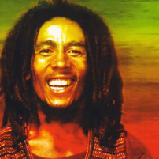
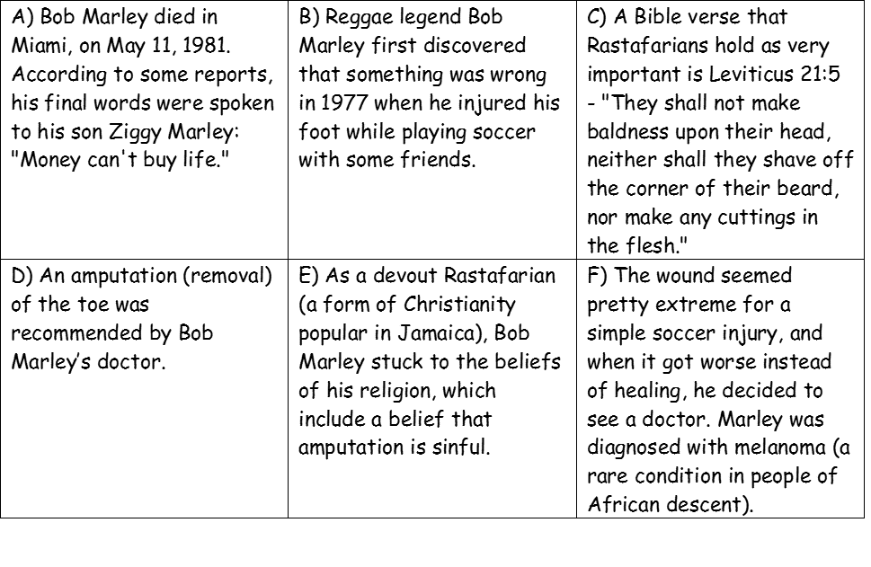
Who has religious objections to medical procedures and why?
Starter –
What happened to Bob Marley’s toe? Order the story correctly

Slide 2
Keywords –
Blood transfusion – when blood from a donor is given to a person who has lost blood in an accident to help them recover.
Transplant surgery – surgery to replace a failing organ, e.g. a kidney from a healthy person may be transplanted into someone with kidney failure.
Jehovah’s Witness – a type of Christian who refuse blood transfusions and transplant surgery (like Rastafarians) on religious grounds.
Question
Explain how an atheist and a religious person could argue against the religious quotes provided.

Slide 3
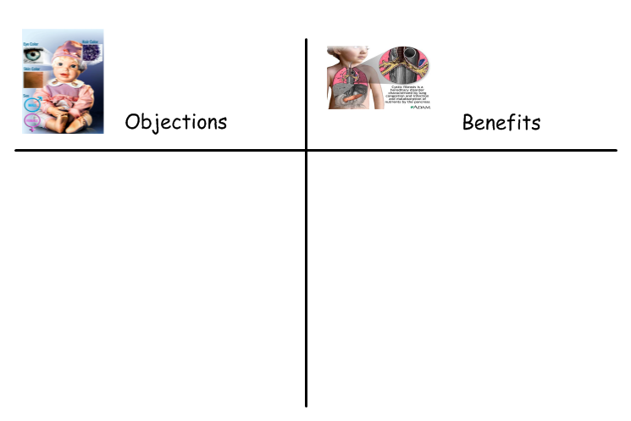
Recap:
Can you explain the objections religious people had towards genetic
engineering that we looked at last lesson?
What were the benefits that scientists said the new
technology would bring?

Slide 4
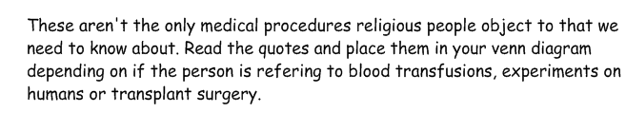
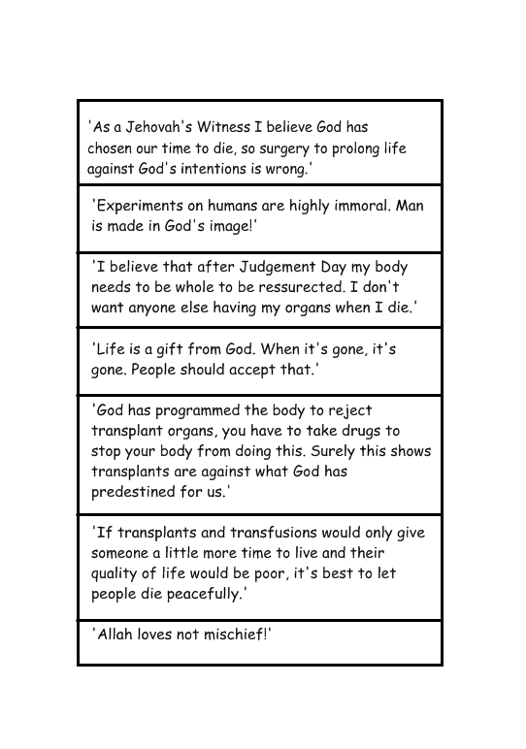
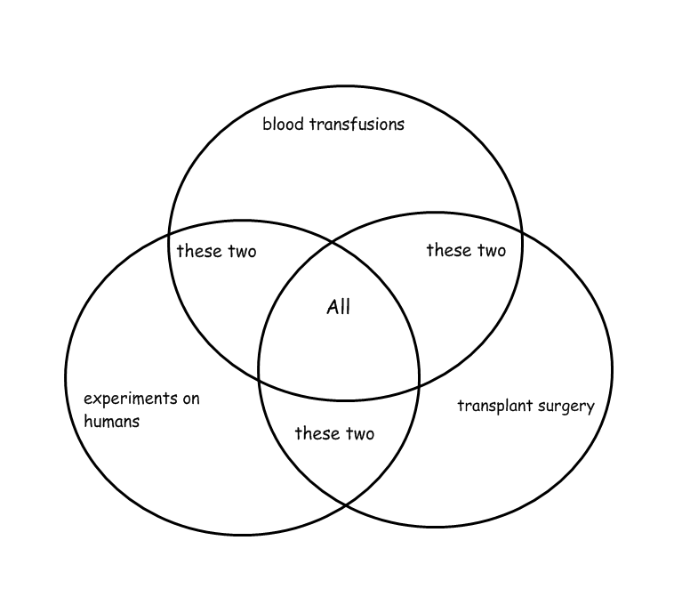
Watch the clip and choose a challenge (A or B)
http://www.youtube.com/watch?v=RFtSiojoi-g
http://www.youtube.com/watch?v=iJE9qk9a_sU
Question
How might a religious person argue against the objections you have just studied? Explain in full.
How might an atheist argue against the objections you have just studied? Explain in full.

Slide 5
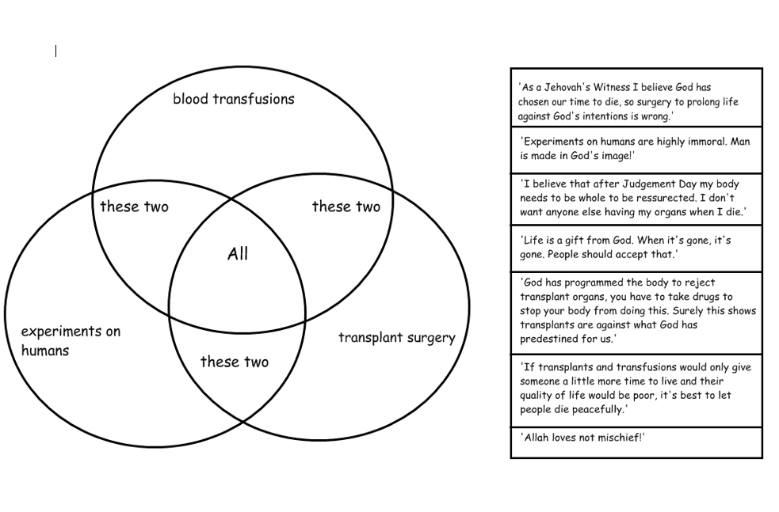
A) REVIEW What did we think?

Slide 6
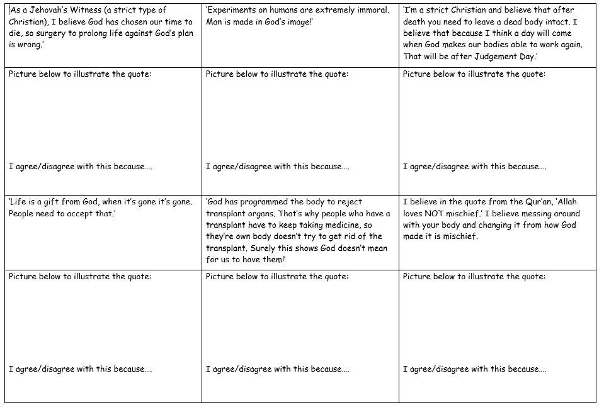
B) REVIEW What did we think?

Slide 7


Key word review:
What is A.I.D?
What is the benefit for couples trying to conceive?
What is A.I.H?
What is the benefit for couples trying to conceive?
What is surrogacy?
What is the benefit for couples trying to conceive?

Slide 8
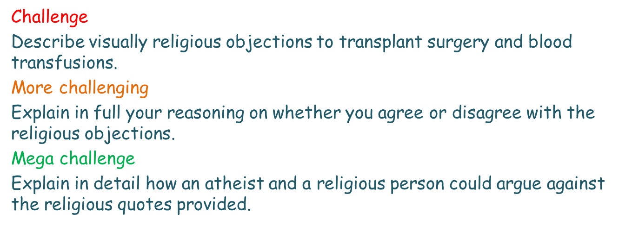
Plenary
Make a mind map of everything we have covered.Be as detailed as possible!

