Slide 1

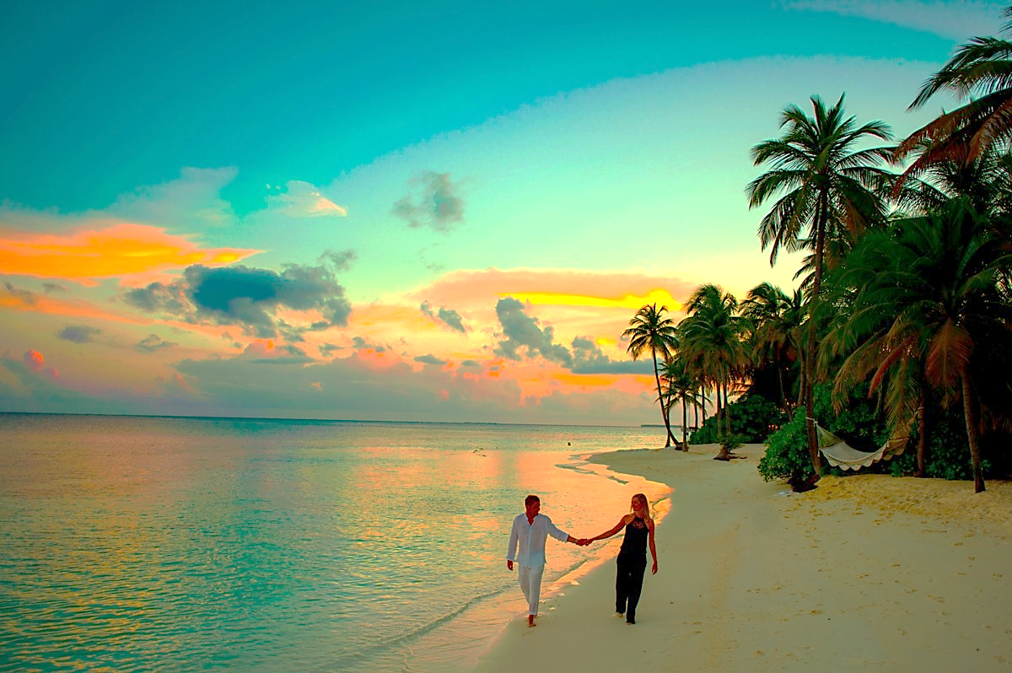

The popular ‘Love Island’ series is being updated. It will now feature 50+ year olds, with a range of body shapes.
They will still be single and the rules and set-up
of the programme will also remain the same.
STARTER:
Will the show be more or less popular? Why?
Explain the impact seeing young, beautiful, sexualy active people as the norm on prime-time TV could have on young teens going through puberty.

Slide 2

Love Island
Spend a few minutes watching the clip below
Most dramatic moments 😱 | Love Island 2021 - YouTube

Slide 3

KEY WORDS:
Objectification – Degrading someone to the status of an object.
Aesthetic norms – What the majority of people perceive to be common physical traits.
Body image - a person's perception of the aesthetics or sexual attractiveness of his or her own body.
Today’s LOs:
Describe how sex, relationships and sexuality are represented in a range of media formats and the possible impact this can have.

Slide 4
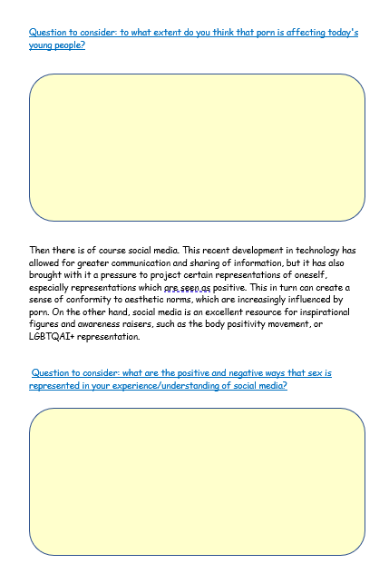
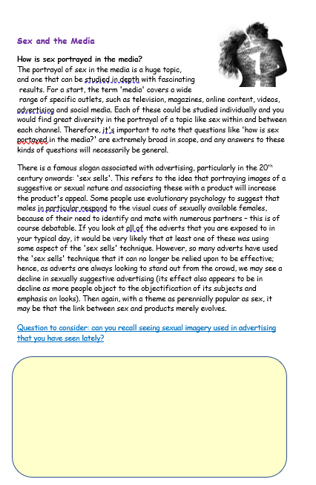
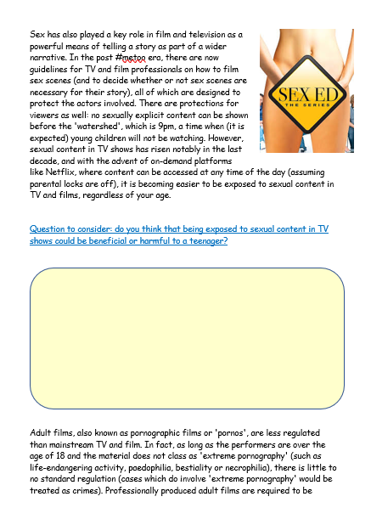
Task One:
Spend the next few minutes, reading the sheet you have been given
in pairs/groups and try and answer the question ready to discuss as a group.

Slide 5
Task 2 –
Watch the clips and answer the questions
https://www.youtube.com/watch?v=-hr58RXDC3o https://www.youtube.com/watch?v=NNCNWk2IHrI
In video 1, what are the main messages portrayed by the media regarding sex?
2. In video 2, what are some positive aspects of social media in regard to its presentation of sexual matters?
3. In video 2, what are some negative aspects of social media in regard to its presentation of sexual matters?
4. Do the positives outweigh the negatives, or vice versa, in your opinion?

Slide 6
PLENARY -DEBATE TIME!
“Young people are growing up in a culture which has a healthy approach to sex.”
Do you agree or disagree? Maybe you can see both sides of this argument.
Today’s LOs:
Describe how sex, relationships and sexuality are represented in a range of media formats and the possible impact this can have.

