Slide 1

What are critical thinking skills? Why do we need these in the modern world?
STARTER:
What questions should we ask about this social media post?
How can we start to investigate the truth behind this post?
Explain the terms ‘critical thinking skills’ and ‘fake news.’

Slide 2

QUESTIONS WE MIGHT ASK:
What is the source for this number?
Are these really ‘facts’?
Who are the St George News? What might their name tell us about their beliefs?
Are they? And is this the reason behind it if they are?
Is it? How do we know?
Are they implying that immigrants are committing lots of crime?
Why do you want us to do this? What’s in it for you?

Slide 3
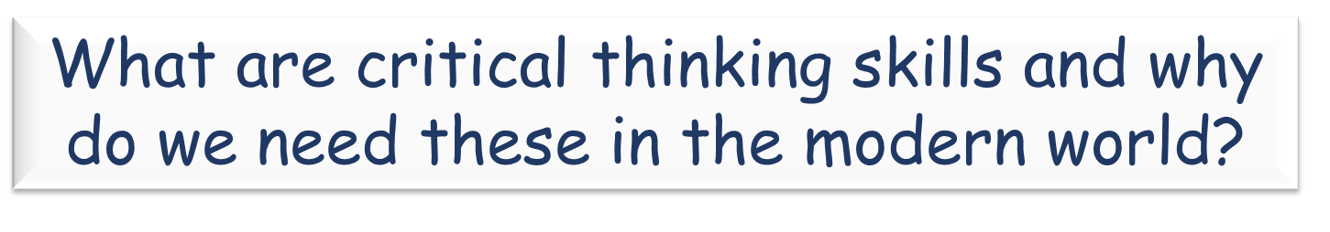
Today’s LOs:
Explain in detail the different aspects of critical thinking and why critical thinking is important. Analyse the validity of a social media post using sources.

Slide 4
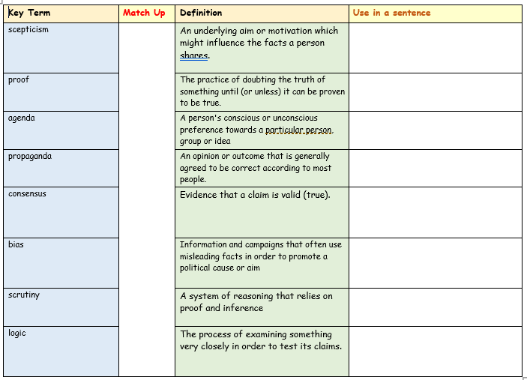

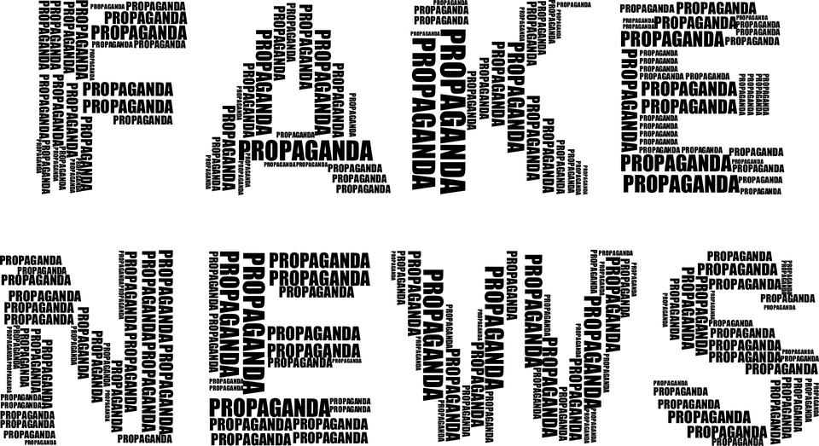
Task One:
How many of today’s key terms do we know already?
Match up the key terms to their definitions

Slide 5
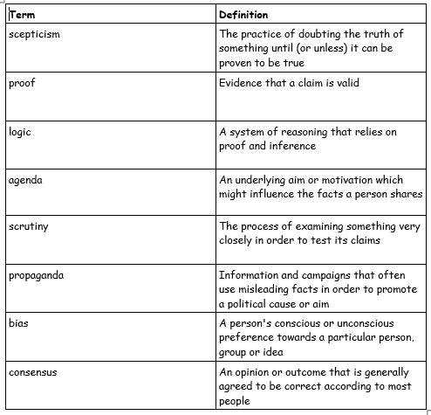
Task One: Answers –
Correct the ones you didn’t get right!

Slide 6
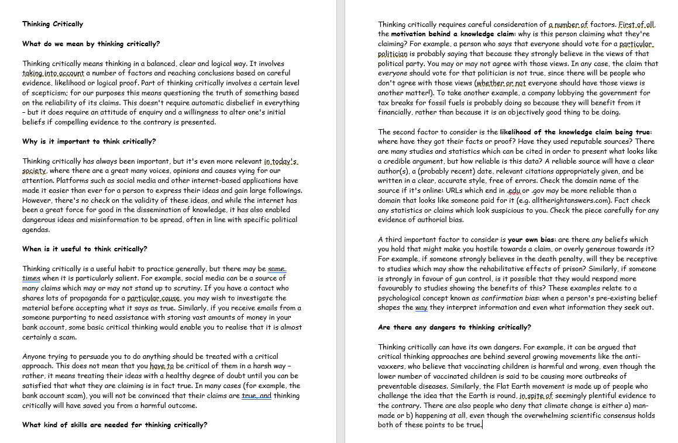
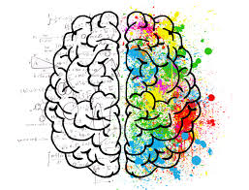
Task Two:
We will now find out more
about what critical thinking
involves, why it’s important
and why it’s such a useful
skill to have.
Read over and discuss as a class any key issues

Slide 7
Task 3 – How can we develop our critical thinking skills?
Watch the clips and answer the questions on your worksheet.
1: https://www.youtube.com/watch?v=iSZ3BUru59A 2: https://www.youtube.com/watch?v=xf8mjbVRqao
Questions
How does the brain take shortcuts?
Describe three ways the brain takes shortcuts:
How can biases ‘blind us’?
What is logic?
What type of articles are disguised as news stories?
Why do we need to compare a range of credible news sources?
What are the Critical ‘5 Cs’?
The second clip says many of a top US university cannot distinguish fake from real news. What does that suggest for the wider global population?

Slide 8
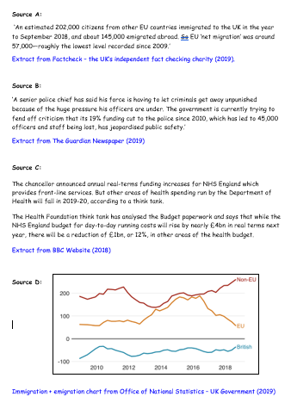
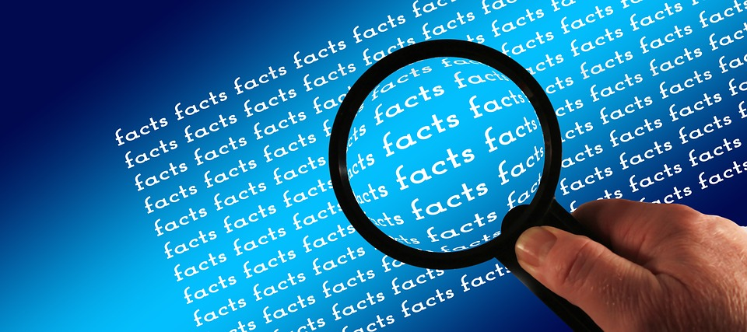
Task Four:
So now we know how to think critically, we can do a little fact-checking.
You have been given a selection of credible sources. These are from a variety of official UK news sources.
Read the sources carefully and Have you opinions on the original post changed? Explain how and why this is.

Slide 9

PLENARY -DEBATE TIME!
“In order to form fair and reasonable opinions in the modern world, we need critical thinking skills.”
Do you agree or disagree? Maybe you can
see both sides of this argument.
ALL –
You have five minutes now to prepare your
own opinion on this statement.
Today’s LOs:
Explain in detail the different aspects of critical thinking and why critical thinking is important. Analyse the validity of a social media post using sources.

