Slide 1


Maintaining positive emotional wellbeing throughout life
STARTER:
Discussion
Explain why we sometimes find it more difficult to have a positive outlook as we reach adulthood.
Cameron was a really happy child. All he thought about was football and videogames. He misses those days. Cameron is now thinking about how he has an essay in for Monday, his girlfriend has dumped him, he has a ten hour shift in a pub tomorrow and he is worried about what he will do when he leaves Sixth Form.
Notes:
With thanks to: https://www.flickr.com/photos/gazeronly/4139824123 labelled as creative commons 2.0 on 4 / 2 /20

Slide 2

Maintaining positive emotional wellbeing throughout life
Today’s LOs:
Describe how different life events and circumstances can affect our mental health and emotional wellbeing through adolescence and adulthood. Describe strategies to manage these.
Watch for a recap on what we mean by mental health: https://www.youtube.com/watch?v=DxIDKZHW3-E

Slide 3

Task 2 –Watch the clip and answer the questions
https://www.youtube.com/watch?v=4KbSRXP0wik
What are the benefits of having a positive outlook on life?
How does stress affect us?
What are our ten basic emotions?
Why does stress affect our gut?
How do our emotions affect us physically?
Why does stress affect us in so many ways and what are the different effects?
How can short-lived stress be a good thing?
How can our emotions affect our hearts?
9. How can our faces help regulate our emotions?

Slide 4

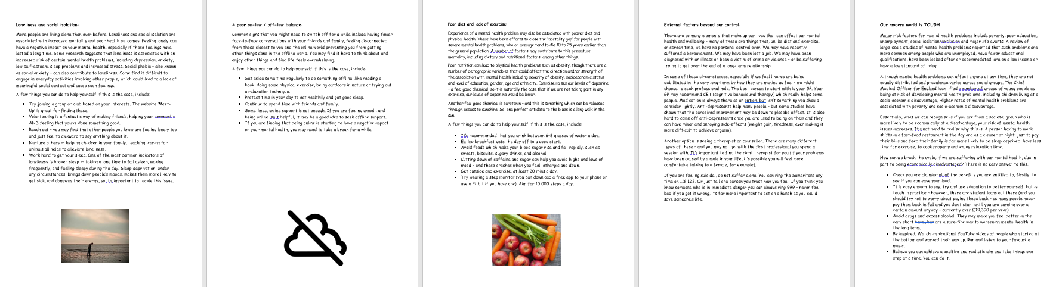
Task 3 – What affects our mental health as we grow into adulthood and how can we make positive changes to improve our emotional wellbeing?
All) In small groups, read your information packs and then read the issues the person on your case study is facing.
Spend a few minutes identifying the issues your case study is facing and why it is affecting their mental health. Talk about it with your group.
Then in one of the boxes, (each group will fill in one box on the A3 sheet) write down three positive actions the person could try to improve their situation.
Are there any situations or actions your case study needs to ensure they avoid? Why is this? Explain (in the same box).
When your teacher tells you your time is up, pass your case study on to the next table. We will review the advice for each case study as class at the end of the task.

Slide 5
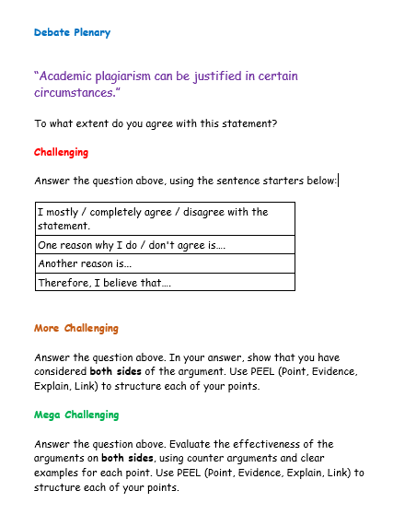


PLENARY -DEBATE TIME!
”We have to work to maintain good
mental health – we can’t just expect
It to happen on its own.”
It
Do you agree or disagree? Maybe
you can see both sides of this argument.
Today’s LOs:
Challenge: Describe how different life events and circumstances can affect our mental health and emotional wellbeing through adolescence and adulthood. Describe strategies to manage these.

