Slide 1

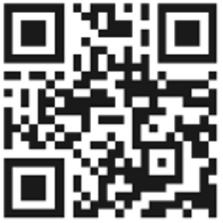


Sleep
Fiona Yoward
EMHP
Notes:
Hello, my name is FY.
I’m an EMHP within the CAMHS WEST team.
West practitioners work in primary and secondary schools and colleges across Herefordshire & Worcestershire.
We support children and young people who experience mild–moderate “common mental health difficulties”, to prevent symptoms becoming more severe
You can find out more about WEST and the support we offer, as well as helpful resources for improving mental health by scanning the QR code on this slide.
This is a brief summary about sleep and sleep difficulties.

Slide 2



What will be covered:
  Why sleep is important
  Things that can make sleep difficult
  Tips for improving sleep
  Websites and further support
Notes:
In this brief session, I will cover why sleep is important and some of the things that can create sleep difficulties.
I will then suggest some tips around improving your child’s sleep.
Finally, I will suggest some websites that offer additional information and mention how your child can be referred to WEST support if appropriate.

Slide 3
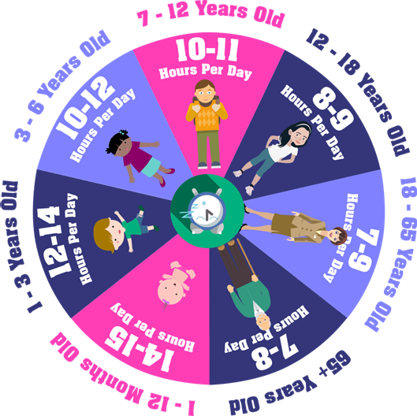
The amount of sleep we need everyday changes as we get older
Notes:
The amount of sleep that we need everyday changes as we grow and develop.
Maintaining a healthy amount of sleep as our needs change can be a real challenge.
But it is important to focus on because sleep difficulties can have a negative impact on many aspects of our lives.
Teenagers need around 8-9 hours of sleep, per night. Despite this, 45% of teenagers in a recent survey, reported getting less than eight hours per night.

Slide 4

Why is Sleep Important?
Getting the right amount of quality sleep will:
Improve concentration, attention span and memory
Let the body rest and repair making sure we can perform well the next day
Reduce stress hormones which is good for our emotional and mental health
Notes:
Getting enough good quality sleep is important.
Good quality sleep improves our concentration, attention span and memory. Sleep gives the brain time to ‘file’ in your memory what it has learnt in the day.
During sleep, our body rests and repairs itself - this helps to the immune system to protect us from illnesses.. If we don’t get enough sleep, we can feel tired and sluggish, and this can impact on things like playing sport or exam performance.
Sleep is also important for our mental and emotional health. You’re more likely to feel down when you’re tired. There is a close link between sleep and mental health. When you sleep better – you feel better.
Making sure children and young people get enough sleep helps them thrive and reach their potential.

Slide 5

Sleep is influenced by internal and external factors
We have a sleep body clock that follows a 24-hour cycle, known as a circadian rhythm.
This body clock is influenced by a sleep hormone called melatonin
Our environment helps our body to regulate this rhythm. This makes it easier to fall asleep at night and wake in the morning.
During the teenage years, the sleep cycle shifts as melatonin is produced later at night.
This can result in teenagers not feeling sleepy until much later in the night and then struggling to wake early in the morning.
Notes:
Sleep is regulated by internal factors within our body and external factors within our environment.
We have an internal body clock that naturally follows a 24-hour cycle meaning that we generally sleep and wake up once every 24 hours. This is known as a circadian rhythm.
This internal clock is influenced by light levels. At sunrise when it gets dark, a hormone called melatonin is released that makes us feel sleepy. In the morning when it gets light, this melatonin production reduces helping us to feel alert.
During the adolescent years, the sleep cycle shifts. Changes in the developing brain results in the sleep hormone melatonin being released later in the evening. This can result in teenagers not feeling sleepy until much later at night. This temporary shift in the circadian rhythm results it being out of sync with environmental factors, such as sunrise and sunset, and often when other family members are going to bed and getting up in the morning.
This may mean that teenagers struggle with falling asleep at an appropriate time, need lengthy lie-ins at the weekend and find it harder to wake up in the morning. This is likely to impact on how they feel the next day. In a school day, this many mean getting up before their body has had enough sleep. This can have a knock-on effect as being overtired makes it even more difficult to fall asleep!
You can’t change the time that school starts but what you can do is encourage your teenager to have a consistent sleep and wake up time to help their body cope better with the early mornings.

Slide 6

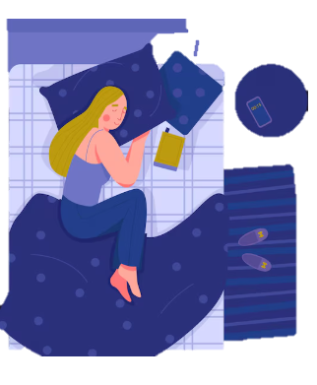


What can make sleeping difficult?
Excessive exercise to close to bedtime.
Feeling worried, sad or scared.
Nightmares/Night terrors
Having an uncomfortable bed.
Bedroom environment
Negative sleep associations
Using your phone before bed
Certain medication
Going to bed hungry or too full.
Feeling ill or being in pain.
Notes:
What can make sleeping difficult?
There are many factors that can make it difficult to get a good night’s sleep.
Some of these include; feeling sad or worried, feeling ill or in pain, or taking certain medications such as antidepressants
A bedroom that is too hot or cold might also be making sleep difficult.
Using technology before bed can also make it hard to fall asleep as the light from a phone or device can disrupt our circadian rhythms.
If your child is struggling with their sleep, have a think about whether any of these factors might be causing their difficulties.
It can be useful to suggest they keep a sleep diary to identify any factors that can be causing sleep difficulties.

Slide 7
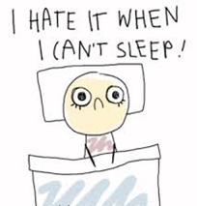

How can young people improve their sleep?
Notes:
So, having looked why sleep is important, the science of sleep and things that can cause sleep difficulties, let’s look at some strategies to help children and young people improve their sleep.

Slide 8

Tip 1: Follow a calming bedtime routine
Try and go to bed and wake up at the same time every day.
Create a relaxing bedtime routine.
Avoid eating a big meal just before bed.
If they can’t sleep, suggest they get up and do something relaxing.
Limit naps to 20-30 minutes a day.
Notes:
Tip 1: Try and stick to a calming bedtime routine
Going to bed and waking up at the same every day will help regulate the internal body clock. The body will soon get into a regular pattern, making it easier to fall asleep at night and easier to wake in the morning. Ideally, this routine should be followed even at the weekend and during school holidays.
It is helpful to create a relaxing bed-time routine such as having a warm shower, listening to music, reading a book. We need to feel relaxed to fall asleep so over time the body will become used to this routine and recognise that we are preparing to sleep.
Eating big meals before bed can cause disrupted sleep. Ideally, the main meal should be eaten at least a couple of hours before bed. This will allow for proper digestion and minimise sleep disruptions.
If your child can’t sleep, it can be helpful for them, to get up and do something relaxing like reading or listening to relaxing music. This tends to reduce the anxiety that can be experienced when we are unable to fall asleep. When they start to feel sleepy again, they can return to bed.
Day-time sleeping reduces the need for sleep at night. If your child has to have to nap, suggest they set a timer and limit naps to 20-30 minutes a day.

Slide 9
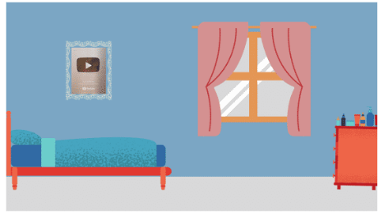
Tip 2: Create a sleep-friendly bedroom
Keeping your bedroom calm and
Keep the bedroom tidy and clutter free.
Avoid extreme temperatures in their bedroom.
Keep the bedroom as dark as possible.
Notes:
Tip 2 is to create a sleep-friendly bedroom
Encourage your child to keep their bedroom tidy. Looking at a pile of homework or revision notes as they prepare to go to sleep, can make them feel worried rather than relaxed.
If it’s possible, try to encourage your child to play with consoles and do homework in a different room in the home so their bedroom can be associated with sleep
We often tend to make our sleeping environment warmer than needed, thinking this might help us sleep. Actually, a cooler room will aid better sleep. Between 16 – 18 degrees is an ideal temperature.
Keep your child’s bedroom as dark as possible. If they need some light to help fall asleep, that’s fine. Perhaps use a night light with a soft glow.

Slide 10

Tip 3: Come off devices an hour before bed
K
Blue light from screens can mimic daylight.
This can affect the production of melatonin, making it harder to get to sleep.
Notes:
Tip 3 is to encourage your child to come off devices at least an hour before bed
According to research, using screens before we go to bed can double the length of time it takes to fall asleep.
This is because the blue light from screens can mimic daylight which lowers melatonin production, making it harder to get to sleep.
Encourage your child to use the blue light filter on devices as this will help. Although we advise avoiding screen time right before bedtime. This isn’t just because of the blue light but because device content is usually stimulating, rather than relaxing.

Slide 11

Tip 4: Reduce caffeine and sugary drinks
Try to avoid caffeine and sugary drinks in the afternoon.
Caffeine is a stimulant that can influence how long it takes to fall asleep, how long we sleep for and the quality of sleep.
Warm milk, oat drinks or caffeine free teas can be good alternatives.
Notes:
Tip 4, encourage your child to reduce their consumption of caffeine and sugary drinks
Tea, coffee and energy drinks can contain high levels of caffeine
Caffeine is a stimulant, which means it increases heart rate and activity in the brain. It takes about five hours, for just half of the caffeine we have consumed, to leave our body!
Sugary drinks raise blood sugar levels which interferes with melatonin levels.
Consuming caffeine and sugar before bedtime can therefore influence not just how long it takes to fall asleep, but also how long we sleep for, and the quality of sleep.
Not all young people are sensitive to caffeine but if your child is having sleep difficulties, it may be worth them avoiding caffeine after 4pm and checking whether this has a positive impact on their sleep.
Warm milk, Oat drinks or caffeine free teas, are a more helpful alternative to improve sleep.

Slide 12

Tip 5 – Do exercise
Aim to get at least 20-30 minutes of exercise each day.
Avoid exercising too close to bedtime.
Notes:
Tip number 5 in improving sleep is to encourage your child to do exercise
Exercise tires the body, promoting a better night’s sleep.
Releasing pent-up tension through exercise is also highly beneficial, helping to reduce stress before bedtime.
Encourage your child to get at least 20 to 30 minutes of exercise each day.
However, they should avoid exercising too close to bedtime. If high levels of adrenaline are still in the body, your child is likely to be too alert to fall asleep.

Slide 13

Tip 6 – Manage your worries
  Write worries down before bed.
  Talk about worries in the day.
  Do something relaxing before bed, such as reading or a mindfulness activity.
Notes:
Tip 6 focuses on strategies to help your child manage their worries
Worry can affect the quality and quantity of your child’s sleep.
It is common for all of us to lie awake thinking about stressful events that we are currently experiencing or feel we might experience in the future.
One helpful strategy is for your child to take some time to work through these thoughts, feelings and emotions before bedtime.
Writing down worries can make them feel easier to deal with, such as in a journal or diary.
Talking to a trusted adult can be helpful to put those worries into perspective and allow your child to be supported in problem-solving or managing those worries.
Doing something relaxing before bed can also be helpful when your child is worried, for example reading a book, doing some mindfulness activities or breathing activities.

Slide 14
Where can I get more information about sleep?
Headspace
https://www.headspace.com/
Smiling Minds
https://www.smilingmind.com.au/
The Teen Sleep Hub
www.teensleephub.org.uk
Calm
https://www.calm.com/
Notes:
I hope you and your child find these 6 tips useful. If you want to find out more information about sleep, here are a few websites with additional resources.
The Teen Sleep Hub - A dedicated site for Teens which also has information for parents/carers. This website has an excellent booklet that your child can work through to help them with sleep difficulties. At the end of their home page is a list of organisations that you child can contact if they are really struggling to cope and would like support.
Calm and Headspace – have resources for meditation and mindfulness.
Headspace
Headspace also has themed sessions on areas such as sleep, stress & anxiety
Smiling Minds
Has resources on mindfulness, including lots of videos.

Slide 15
Thank you for listening!
I hope this has been useful.
www.camhs.hacw.nhs.uk/west
If you feel your child would benefit from a referral to our WEST team to support them with their mental wellbeing, please speak to your child and school.
Notes:
Thank you for listening and I hope this has been useful.
If you feel your child would benefit from a referral to WEST for support with their mental wellbeing, please speak to your child and school.
More information can be found on the WEST website, using the address or QR code on this slide.

