Slide 1
WHERE IS EVERYTHING?!
Using the PHS School Site Map, try to find answers to the following questions:
(rooms in brackets mean they are upstairs in the that Block or area)
What subject is carried out in A1?
How many classrooms are there in Science?
What subjects might you do in H1-H10?
Name one room where you might find some Technology going on?
There are two rooms where you might have PE. What are they?
Where might you go for lunch?
Where is the medical room located?
If you need a bit of extra help you might spend time in the Inclusion Centre. What is upstairs?
Why do rooms Q1 – Q8 start with the letter ‘Q’ do you think?
In which subject block will you find the Library?
What is located near the Caretaker’s Hut that might be useful?
Apart from the Kitchen/Dining room, where else might you be able to buy food if you are not in the Sixth Form?
If you had a question about almost anything during the day, the staff at the Student Hub would help. Where would you find it?

Slide 2
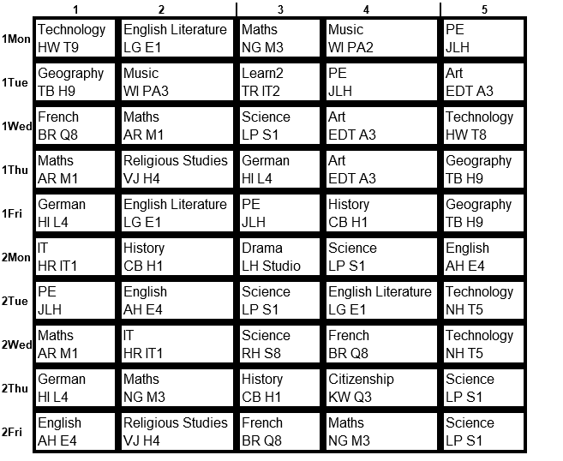
FINDING MY WAY AROUND (1)
Now study the dummy timetable below. This is not your actual timetable for next year – you will find this out when you arrive on your first day in school in September.
This shows you our two week timetable with Week 1 (e.g. 1Mon) and Week 2 (e.g. 2Mon). You will notice that each week is different. Along the top is the lesson number (e.g. 1; 2, etc)
The timetable shows (using 1Mon1 as the example):
The subject e.g. Technology
The teachers initials e.g. HW
The room number e.g. T9
Now use the timetable to answer the questions on the next slide

Slide 3
FINDING MY WAY AROUND (1)
Imagine you were telling your parent/carer how you moved around from lesson to lesson – can you write clear directions using the PHS School Site Map to help for the three examples below?
1. It is Week 1 Monday morning. You have just had Technology in T9 and need to go to English Literature in E1 – how would you get there?
To get to E1, I would…
Can you also find when on the timetable you do the reverse journey from English Literature back to a (different) Technology Room:
2. It is Week 1 Wednesday morning. You have just had Science in S1 and you need to go to Art in A3 – how would you get there?
To get to A3, I would…
Can you also find how many Science and Art lessons you have during each two week cycle: Science: Art:
3. It is Week 2 Thursday morning. You have just had Maths in M3 & you need to go to History in H1 – how would you get there ?
To get to H1, I would…
What have you noticed about the room letters for most of the subjects on your timetable

Slide 4
FINDING MY WAY AROUND (2)
There are clearly times when you don’t just need to get between lessons but to and from other places in the school
Imagine you were in charge of telling others how to find their way around – can you write clear directions using the map to help?
1. If you start at the student entrance, how would you get to the Drama Studio?
To get to the Drama Studio, I would…
2. If you had Science just before break, how would you get to the Dining Room to buy a snack?
To get to the Dining Room, I would…
3. If you had Art last lesson, how would you find your way to the cycle shed to pick up your bike to get home?
To get to the cycle shed, I would…
Well done for having a go at these tasks

