Slide 1
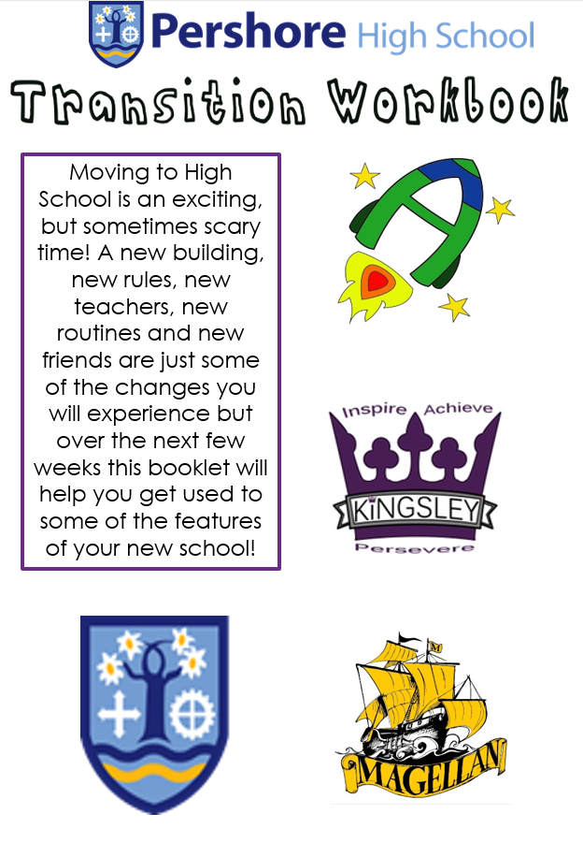

Slide 2
All about me
Draw a self portrait or put a picture you like here:
Name:
Birthday:
My Current School:
Eye Colour:
Hair Colour:
Height:
My favourite school subject is…
The topic I know most about is…
My best skill is…
Friends would describe me as…
If I could have a superpower, I’d…
My dream country to visit would be…
If I could travel back in time, I’d go to…
My dream job is…

Slide 3


My journey so far
Life is a journey! Think back through your school life and write down your favourite memories or events (you can use text boxes) that have shaped you to become the amazing person you are!

Slide 4
Moving to your new school
List 4 things you are most excited about when moving to Pershore High School:
List 4 things you are a little worried/nervous about:
List 4 things you would like to know about Pershore High School:
List 4 things that will help you when moving to Pershore High School:
List 4 differences between your current school and Pershore High School that you already know about:

Slide 5

My goals for high school
When you go to High School, you will learn a huge number of new skills, and improve skills you have practiced in your current school. In the goal below, use the list, or your own ideas, to write (using text boxes) 10 new skills or things you’d like to build on during your years at High School.
Be in a school play or production | Speak another language | Represent your school in a national competition
Learn to play a musical instrument | Volunteer in the local community | Travel to another country
Play for a school team | Learn how to survive in the wild | Take care of the school environment
Learn how to manage money | Design and make something useful | Earn House points
Cook a new meal from scratch | Read new books | Take part in a school assembly
Create a piece of art | Raise money for charity | Become a Representative
Learn how to read a map | Join an after school club | Learn to dance
Use computers to create your own website | Learn First Aid | Sing in the school choir
Make new friends from other schools | Work as part of a team | Try camping

