Slide 1
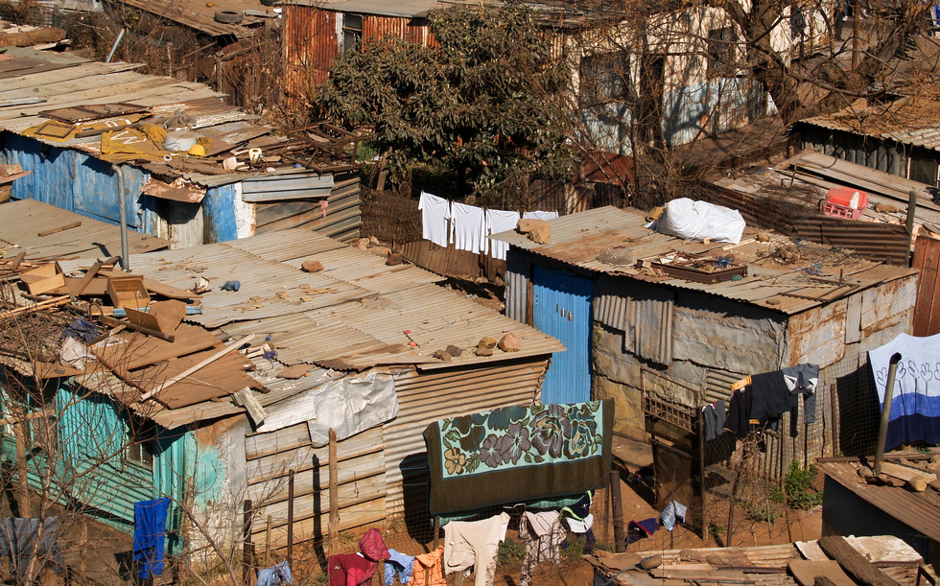








Local, national, International and global areas of interest
  Where you live
  Travel & tourism
  Charity work
  Healthy & unhealthy living
  The environment
  Poverty & homelessness
What will we study?
3 Themes
Identity and culture
  Types of family
  Relationships
  Marriage/partnerships
  Social media
  Music
  Cinema & TV
  Food
  Sport
Current and future study
and employment
  Your studies
  Life at school
  Education after GCSEs
  Jobs, careers & ambitions

Slide 2





How will I be assessed?
SPEAKING
READING
25% of GCSE
2 minute role-play
3 minute discussion of a photo card
5-7 minute general conversation
25% of GCSE
Questions in English and the target language
Translation from target language into English
WRITING
25% of GCSE
Two writing tasks
Translation from English into target language
LISTENING
25% of GCSE
Questions in English and the target language

Slide 3


Creativity is increased
Foreign language study enhances listening skills and memory
You participate more effectively and responsibly in a multi-cultural world
Why study languages?
International travel is made easier and more memorable
Add language skills to your skill set and you are instantly more valuable in the market place
Studying a foreign language means you understand your own language far better! Your English will vastly improve!

