Slide 1
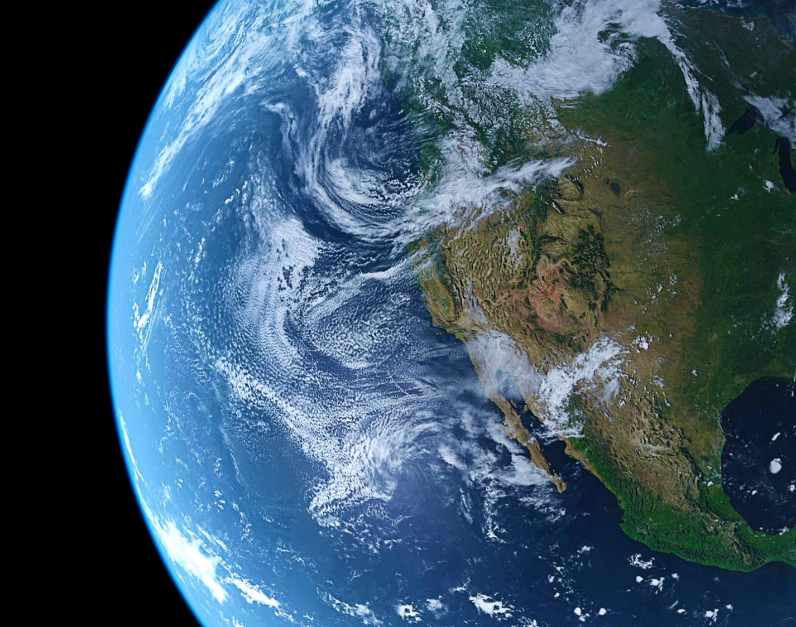
The World beyond Pershore…. and in Pershore

Slide 2

We have had the ISA for many years and were re-awarded this badge of honour in September, 2020.

Slide 3
What do we do here at PHS?

Slide 4
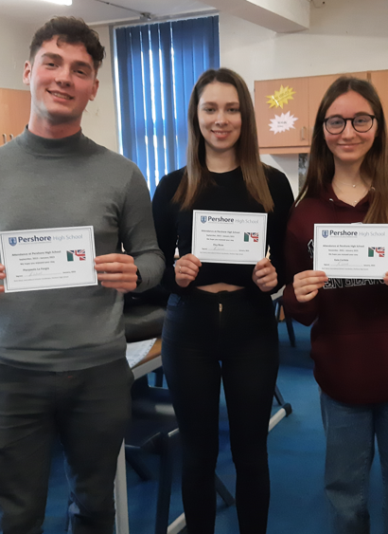
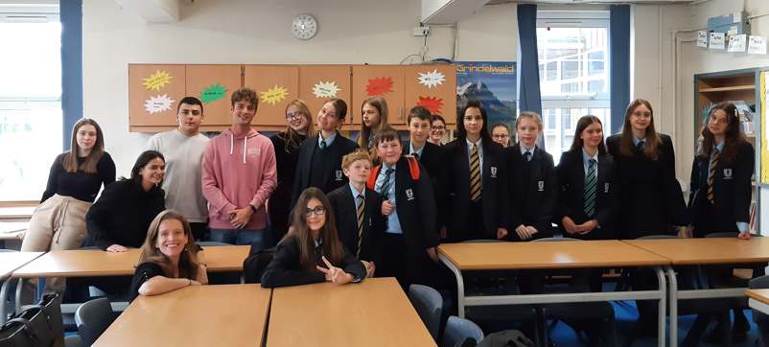
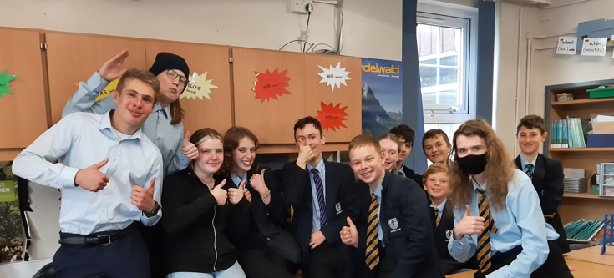
Notes:
This year we have had various visiting students with us: here is a selection. They have often visited us in Language Club and shared their knowledge. Some of you knew Sebastian and Pedro from Colombia, or our Year 12 Italians: Pierpaolo, Alfredo, Elsa and Elenora. We had 3 Germans with us for a month and next half term we will have a number of guests with us at Pershore: 6 Germans will be with us in the first week, followed by 5 students from Spain and we will also have an Italian with us as well as a couple of students from France.

Slide 5
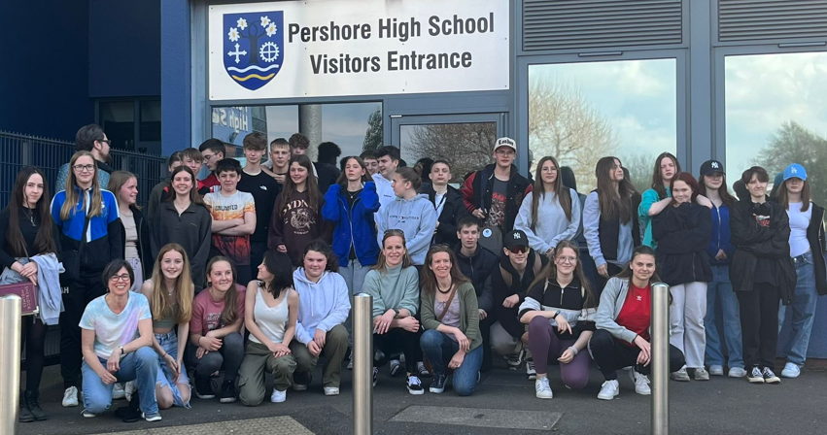
Notes:
German Exchange – this isn’t just about learning more German, but about friendships being made and getting to know another country and culture

Slide 6
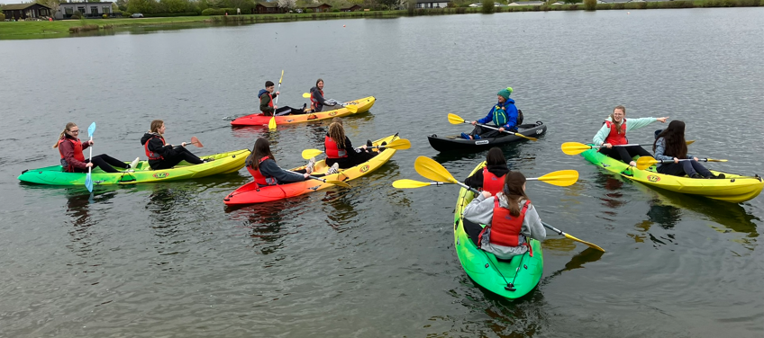
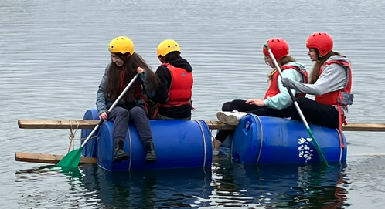
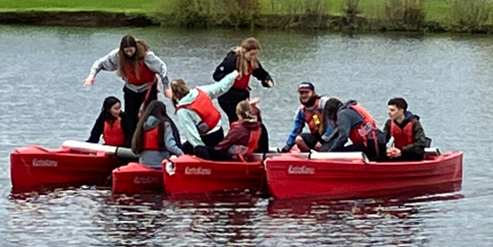
German Exchange – braving the waters of Aztec water park
Notes:
We undertook various activities with the Germans and they were very much part of the school. On the Monday, students taking part in the exchange got to know each other well by having to cope with various challenges (and the weather!) at Aztec!

Slide 7
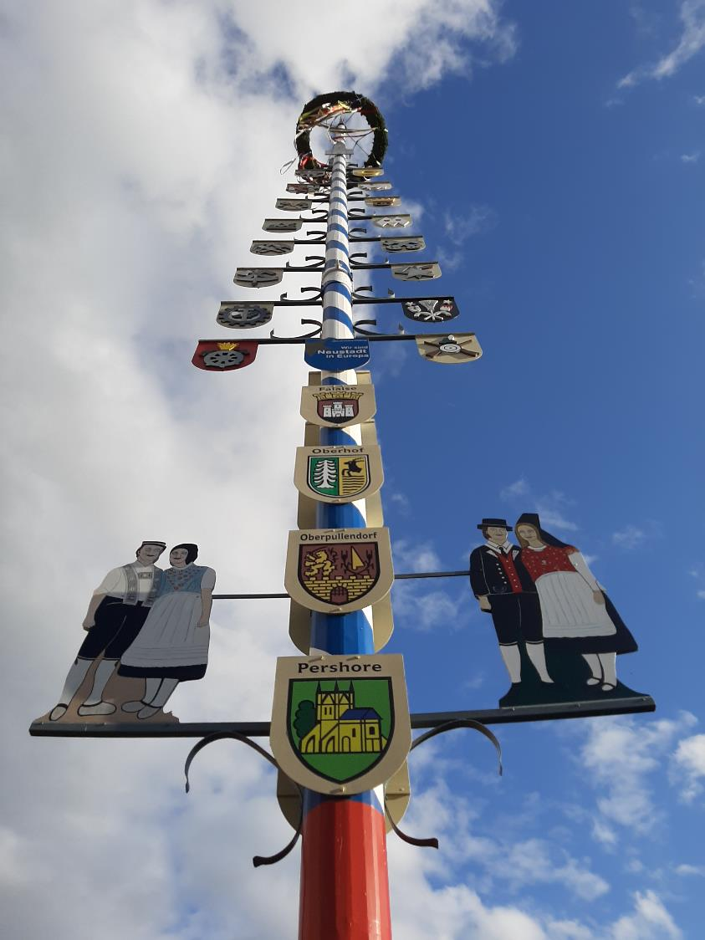
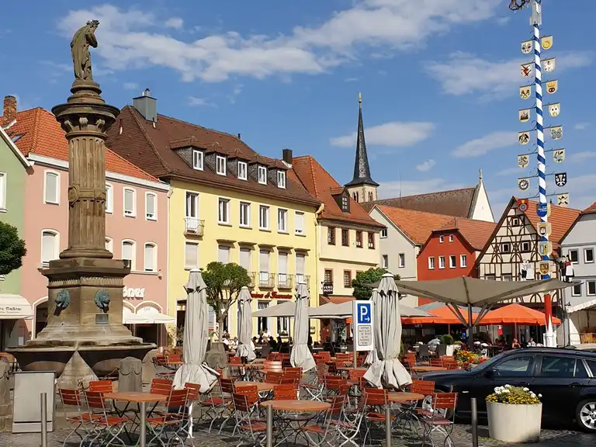
We’re returning to Germany in July
Notes:
A few impressions of Bad Neustadt an der Saale where we will be returning to. Note that Pershore features on the maypole which is in the centre of the town.

Slide 8
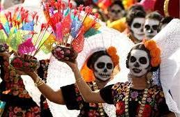
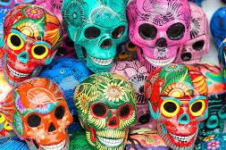

KS3 Art Club has been investigating the Mexican tradition of Day of the Dead
Notes:
This club has been very popular and has focused on not only the tradition of Day of the Dead, but also the language spoken in Mexico (with the help of the MFL department), the geography of Mexico (with the Geography department), students made biscuits on the theme (with the Food department)….

Slide 9
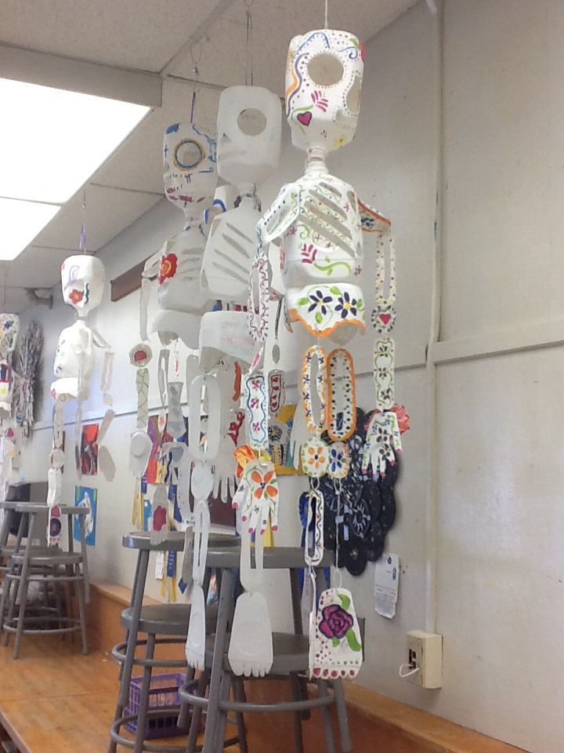
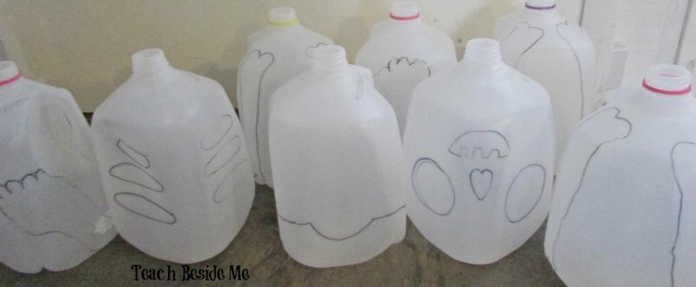
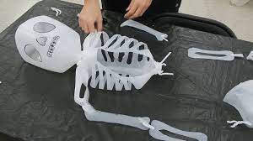
milk bottles were used to make skeltons
- a creepy recycle project!
Notes:
And the Art Department helped with this creepy art project!

Slide 10
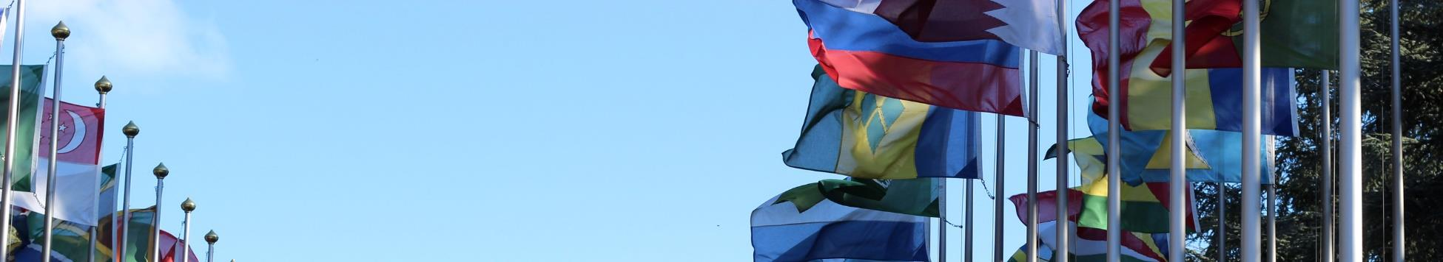


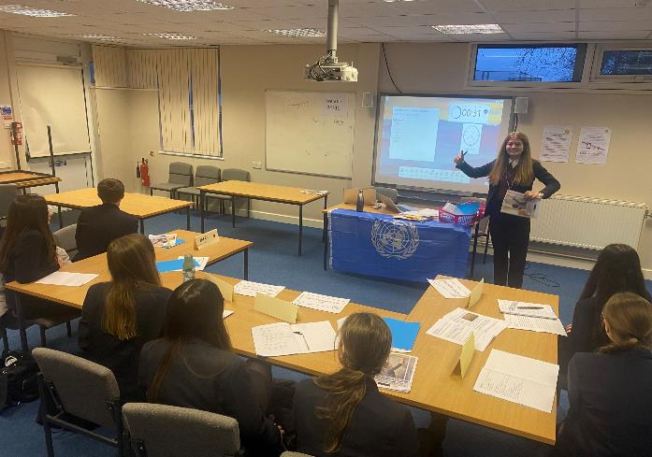
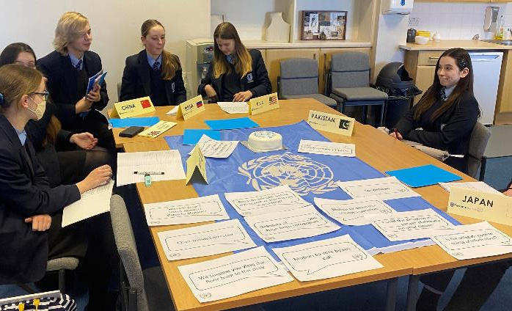
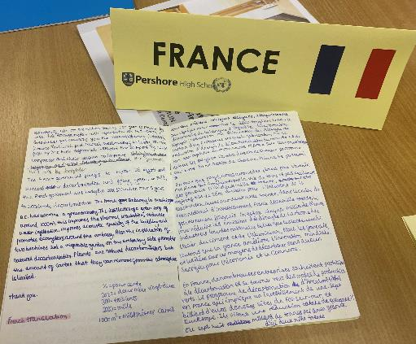
Model United Nations (MUN) is an imitation of the United Nations where students play the role of different delegates from different countries and attempt to resolve global issues with the policies and perspectives of their assigned country.
MUN
Notes:
The MUN helps students understand more the workings of the UN and how countries collaborate.

Slide 11
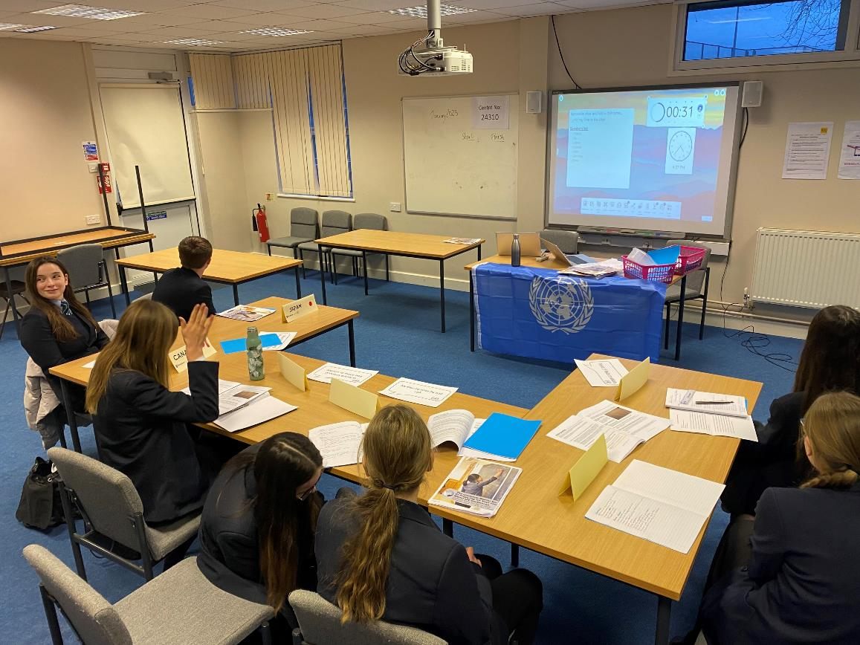
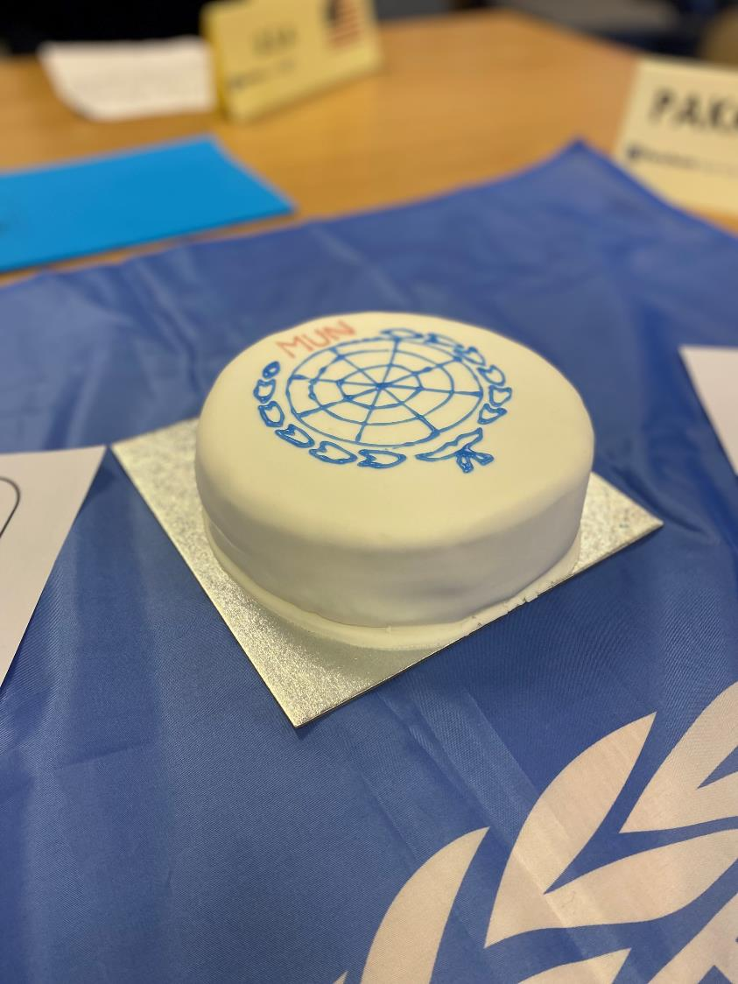

Slide 12
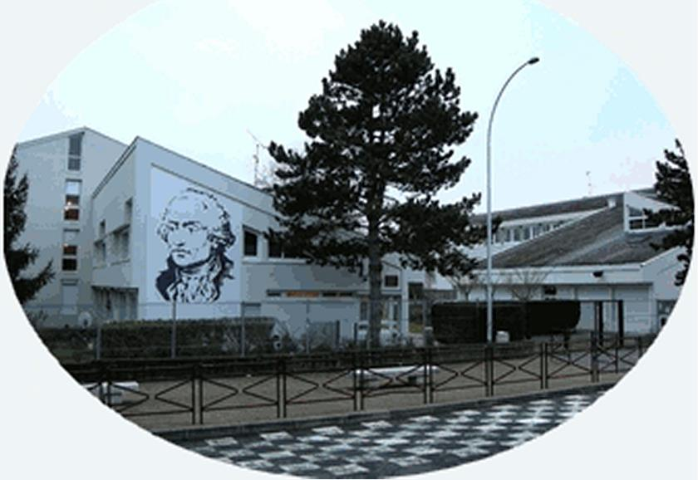
Thanks to Miss Laisney, we have created links with her old school in France – the College Condorcet in Dourdan
Notes:
We have different links with schools in other countries……This school in France has students who have been in touch with some of our students across the Key Stages.

Slide 13
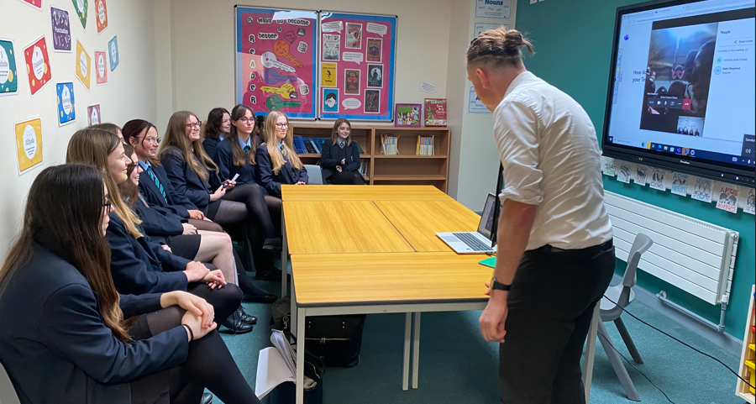
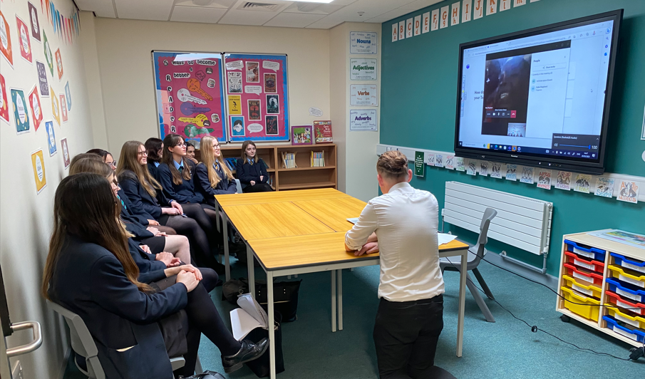
Pen-pal project with BAHASI orphanage in Malawi
Notes:
An orphanage in Malawi has had a video exchange with our students and they are in contact with a group of Pershore students.

Slide 14
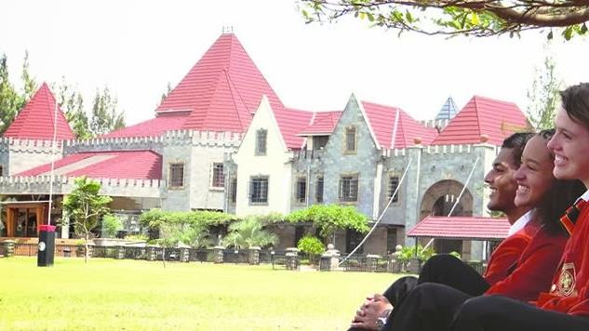
We have a link with a school in Nairobi, Africa – Brookhouse.
This partnership was forged through the Rivers of the World British Council project.

Slide 15
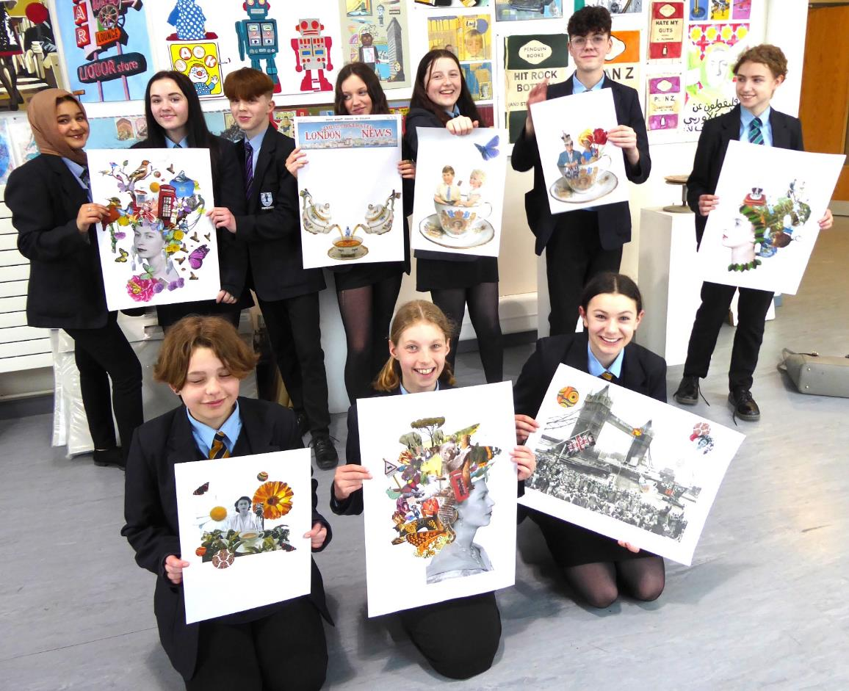
YEAR 8 AND 9 ARTCLUB WORKSHOP PARTICIPANTS.
Notes:
The late Queen visited Kenya in 1952 and so students last year used the nature and wildlife of Kenya to inspire them on this River of Hope art project.

Slide 16
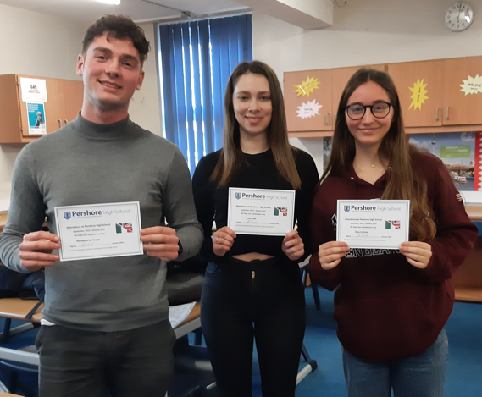
Pierpaolo has kept in touch and is helping Mrs Kiddle run an Italian pen-pal project
Notes:
Through Pierpaolo, we have an Italian school linked to us with whom we are in regular contact.

Slide 17
The World is bigger than Pershore – get ready for it!

